Slide 1
Introduction to PHP

Slide 2

PHP
It is not an acronym for anything.
An open source web scripting language.
A PHP page is always interpreted by the server when it is requested.
The latest version is PHP 7.4.
Have to learn an entirely new language.
Reference: http://www.php.net/

Slide 3
What is it?
PHP is a server side scripting language commonly used on web servers.
Stands for “PHP: Hypertext Preprocessor”
Open source
Embedded code
Syntax based on Perl, Java, and C
Very good for creating dynamic content
Powerful
we use PHP to create dynamic web applications. Although, PHP is easy to learn and use, it gives us all features to create a dynamic website. In other words, PHP allows us to process the form data, interact with the database, upload, and download files, send mails, state management, session management, and so on.

Slide 4
What can it do?
Dynamic generation of web-page content
Database interaction
Processing of user supplied data
Email
File handling
Text processing
Network interaction
And more…

Slide 5
Features of PHP
Since PHP code can be used along with HTML, we don't need a separate file to write code.
PHP is a scripting language.
It is much faster in comparison to other scripting languages
Unlike JavaScript, we use it for server-side web development.
Since it is open-source, it is one of the most popular web development languages. Moreover, there is lot of online documentation available making it easier to use. Also, it has a large developer community.
PHP is interpreted rather than compiled.
It has object-oriented features that allow us to define our own classes and create objects.
Since it is a loosely-typed language, we don't need to associate a specific data type while creating variables.
PHP is platform-independent.

Slide 6
Drawbacks of PHP
PHP is not suitable for creating large enterprise applications.
It is less secure due to poor programming practices by many programmers.
The use of some of the PHP frameworks may cause performance degradation.
The code developed in PHP is less manageable.
PHP doesn't have an adequate debugging facility.
Weak typing may result in unexpected bugs.

Slide 7
History
Started as a Perl hack in 1994 by Rasmus Lerdorf (to handle his resume), developed to PHP/FI 2.0
By 1997 up to PHP 3.0 with a new parser engine by Zeev Suraski and Andi Gutmans
Version 7.4 is current version, rewritten by Zend (www.zend.com) to include a number of features, such as an object model
PHP is one of the premier examples of what an open source project can be

Slide 8
PHP Language Basics
Lexical Structure
Data Types

Slide 9
Lexical Structure
PHP is embedded within xhtml pages within the tags: <?php … ?>
The short version of these tags can also be used: <? … ?>
Each line of PHP is terminated with a semi-colon.

Slide 10
Display ‘Hello World!’ in PHP
<html>
<head>
<title>PHP Test</title>
</head>
<body>
<?php echo ‘<p>Hello World!</p>’; ?>
</body>
</html>
Notes:
Using your favoured text editor (e.g. Notepad) create the file on the slide…
Save it in your web space as hello.php and navigate to the file via your web browser
You should see
Hello World!
On the page…
If that has worked replace all with phpinfo(); and run again…
You should now see a page with lots of information about the PHP installation – this will become useful later!
NOT XHTML (NO DOCTYPE SETTING ETC) TO SAVE SPACE ON PAGE…

Slide 11
Literals..
All strings must be enclosed in single of double quotes: ‘Hello’ or “Hello”.
Numbers are not in enclosed in quotes: 1 or 45 or 34.564
Booleans (true/flase) can be written directly as true or false.

Slide 12
Comments
// This is a comment
/* This is a comment that is spread over multiple lines */
Do not nest multi-line comments
// recommended over #

Slide 13
Comments
<?php
// this is a comment
echo ‘Hello World!’;
/* another
multi-line comment */
?>

Slide 14
Displaying Data
There are two language constructs available to display data: print() and echo().
They can be used with or without brackets.
Note that the data ‘displayed’ by PHP is actually parsed by your browser as HTML.

Slide 15
echo
echo is a statement i.e used to display the output. it can be used with parentheses echo or without parentheses echo.
echo can pass multiple string separated as ( , )
echo doesn't return any value
echo is faster then print

Slide 16
Print
Print is also a statement i.e used to display the output. it can be used with parentheses print( ) or without parentheses print.
Print function doesn’t take multiple argument
print always return 1
it is slower than echo

Slide 17
Displaying data
<?php
echo ‘Hello World!<br />’;
echo(‘Hello World!<br />’);
print ‘Hello World!<br />’;
print(‘Hello World!<br />’);
?>

Slide 18
Escaping Characters
Some characters are considered ‘special’
Escape these with a backslash \
Special characters will be flagged when they arise, for example a double or single quote belong in this group…

Slide 19
Escaping Characters
<?php
// Claire O’Reilly said “Hello”.
echo ‘Claire O\’Reilly ’;
echo “said \”Hello\”.”;
?>

Slide 20
Data Types
Scalar Type [Single-Value]
Integers, float, strings, boolean
Compound Type [Collection Type]
Arrays and objects
Special Type : Resource and Null

Slide 21
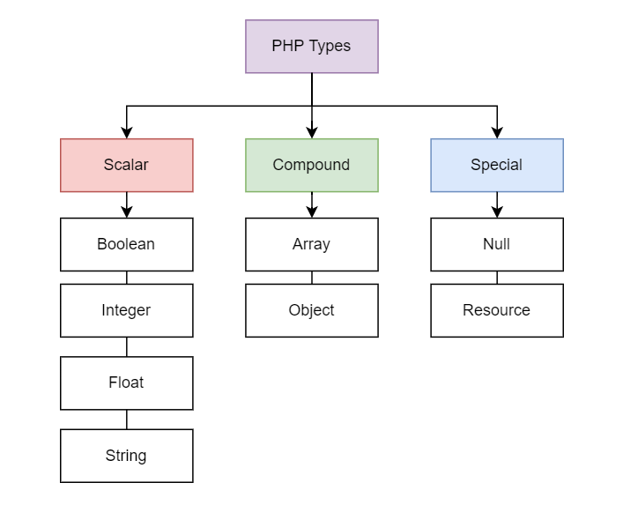
Data Types

Slide 22
Scalar types
A variable is a scalar when it holds a single value of the type integer, float, string, or boolean.
Integer
Integers are whole numbers defined in the set {…-3,-2-,-1,0,1,2,3…}. The size of the integer depends on the platform where PHP runs.
Float
Floats are floating-point numbers, which are also known as floats, doubles, or real numbers.
Boolean
Boolean represents a truth value that can be either true or false. PHP uses the bool keyword to represent the Boolean type.
String
A string is a sequence of characters surrounded by single quotes (‘) or double quotes (“).

Slide 23
Compound types
Compound data includes the values that contain more than one value.
PHP has two compound types including array and object.
Array
An array is an ordered map that associates keys with values.
Object
An object is an instance of a class.

Slide 24
Special types
PHP has two special types: null and resource
Null
The null type has one value called null that represents a variable with no value.
Resource
The resource type holds a reference to an external resource, e.g. a filehandle or a database connection.

